Slide 1

Welcome to South Plains College!
We will begin shortly!

Slide 2
Dual Credit Basics
What is Dual Credit? A system under which an eligible high school student enrolls in college course(s) and receives credit for the course(s) from both the college and the high school.
What courses are eligible?
Those in the core curriculum of the public institution of higher education providing the credit;
a career and technical education course; or
a foreign language course.
*No developmental education or remedial courses can be offered for dual credit.
Notes:
Grade Level Eligibility
High school students-as agreed upon in local policy
Dual Credit Course Load
No limit in rules-as agreed upon in local policy

Slide 3
Dual Credit Basics (cont.)
Eligibility to Enroll in Dual Credit Courses –
Demonstration of TSI college readiness or exemption
  TSI Assessment
  ACT
  SAT
  Algebra II STARR EOC
  English III STAAR EOC
Dual credit course enrollment eligibility (not college readiness)
  English II STAAR EOC
  Algebra I STAAR EOC plus passing grade in Algebra II course
  PSAT/NMSQT
  Aspire
Not required for dual credit courses contained in a Workforce Education Level 1 Certificate.

Slide 4
Dual Credit Basics (cont.)
Exception -
An Early College Program Course…
Any college course for dual credit offered as part of an early college program must be a core curriculum course of the public institution of higher education providing the credit, a career and technical education course, a foreign language course, or course that satisfies specific degree plan requirements leading to the completion of a Board approved certificate, AA, AS, AAS degree program, or FOS.

Slide 5
Dual Credit Basics (cont.)
Curriculum
The college shall ensure that a dual credit course and the corresponding course offered at the main campus of the college are equivalent with respect to curriculum, materials, instruction, and method/rigor of student evaluation.
Faculty
Faculty must meet the same standards and approval procedures used by the college to select faculty responsible for teaching the same courses at the main campus of the college.
The college shall supervise and evaluate instructors of dual credit courses using the same procedures used for faculty at the main campus of the college.

Slide 6

Policy Updates
SACSCOC
July 2018 – new “Dual Enrollment” policy is released, following June Board meeting.
December 2018 – new “Dual Enrollment” policy is revised.

Slide 7
Policy Updates (cont.)
86th Texas Legislative Session
SB 25 – Transfer/Advising/Dual Credit
Recommended Course Sequences
Reporting of Nontransferable Credit
Dual Credit Degree Plan (this requirement is also found in SB 1324).
Notes:
Allows dual credit courses in Fields of Study or Programs of Study to be formula funded

Slide 8
Policy Updates (cont.)
86th Texas Legislative Session (cont.)
SB 1276 – Partnership Agreements
This bill expands on the details required for an agreement between a public school district and their dual credit provider.
HB 3650 – Use of Open Education Resources (OERs)
This bill requires any agreement made between a school district and a public institution of higher education to provide for a dual credit program to consider the use of free or low-cost open educational resources in courses offered under the dual credit (September 1, 2019).

Slide 9
Policy Updates (cont.)
TSIA 2.0
The Texas Higher Education Coordinating Board is in the process of renewing the contract with the College Board.
Anticipated Changes:
  Alignment to revised standards
  Integrate Reading and Writing
  Improve transportability of test results
  Reduce diagnostics to one test
  Effective date: Fall 2020*
* Current TSIA scores can be used for fall 2020 placements

Slide 10
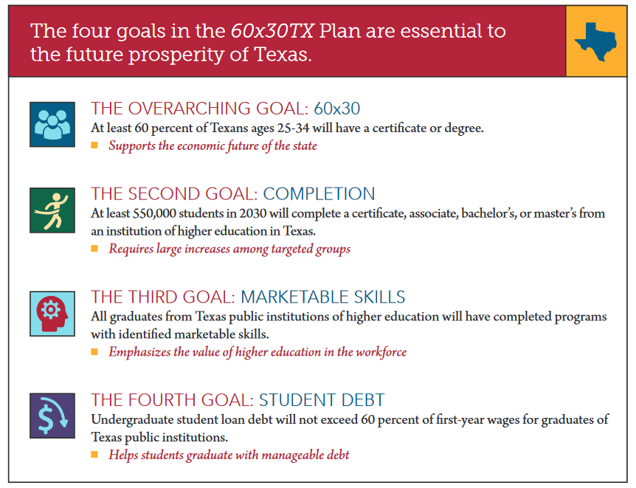
Texas Higher Education Strategic Plan: 2015-2030
60x30TX

Slide 11

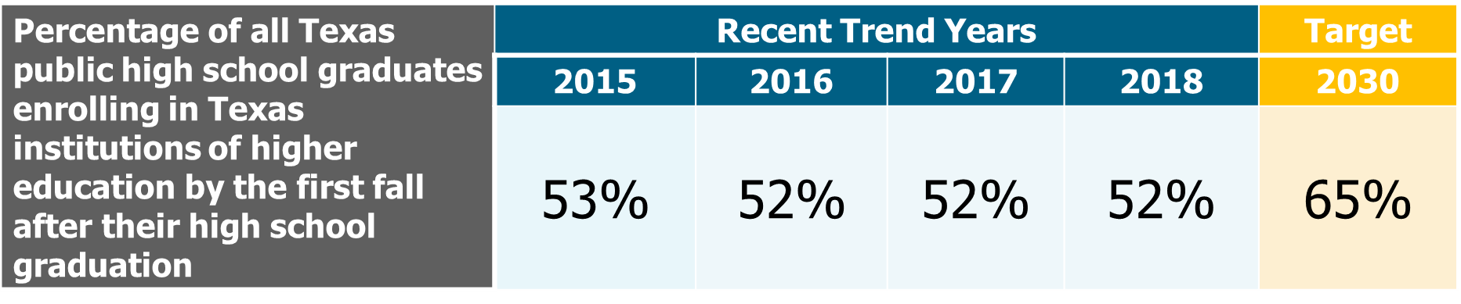
60x30TX (cont.)
The 60x30TX completion goal includes a targets of increasing the percentage of Texas public high school graduates enrolling directly into Texas colleges.

Slide 12
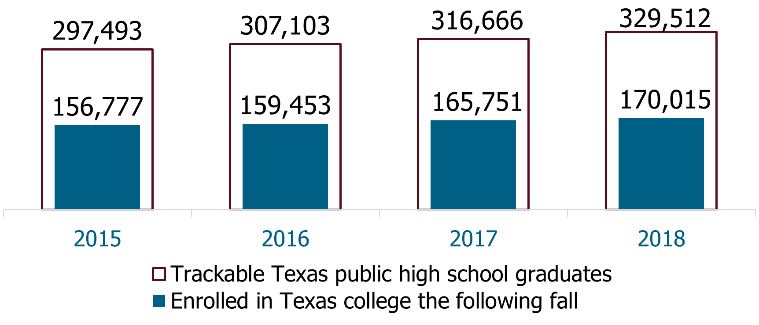
60x30TX (cont.)
Overall college enrollments have increased each year:

Slide 13
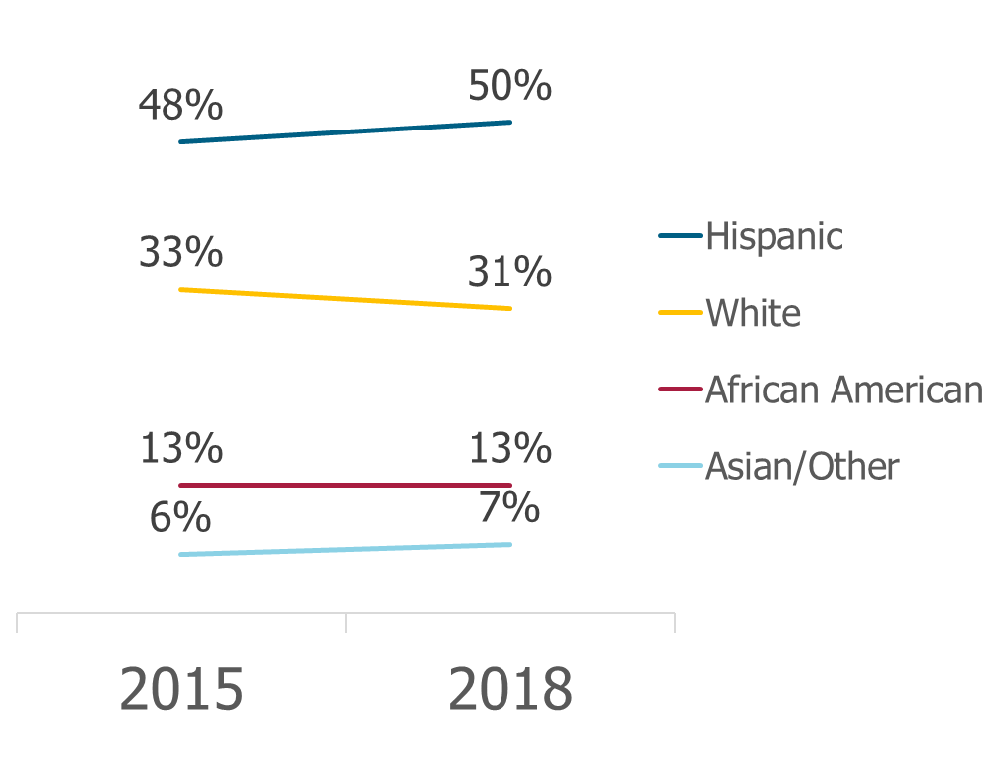
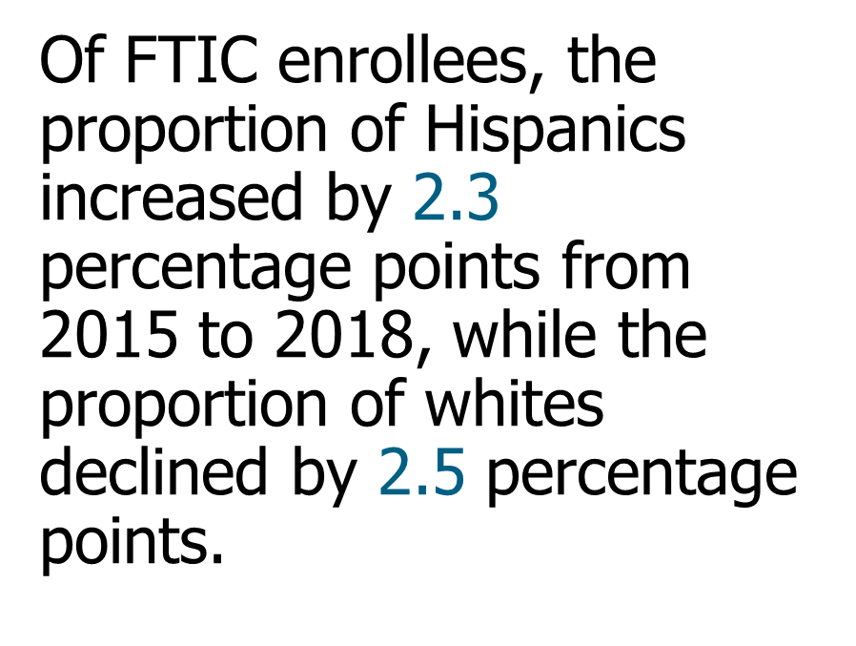
60x30TX (cont.)
Hispanics have been the fastest growing demographic among Texas public high school graduates.

Slide 14
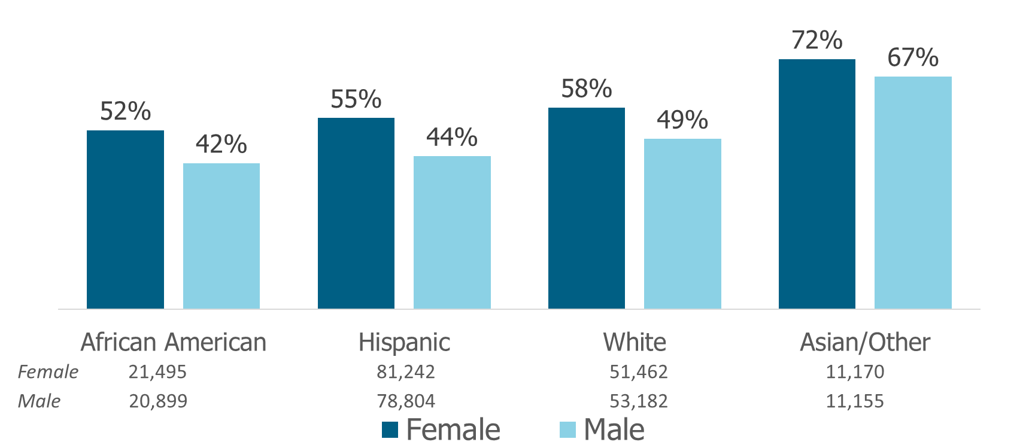
60x30TX (cont.)
Hispanics and African Americans continued to have the lowest direct enrollment rates.
Notes:
Economically disadvantaged males have the lowest direct enrollment rates.

Slide 15
Financial Aid Update
Susan Nazworth, Director of Financial Aid

Slide 16
Business Office Update
Janet Pino, Assistant Director of the Business Office

Slide 17
Admissions Update
Kathryn Perez, Dean of Admissions
JimAnn Batenhorst, Dual Credit Coordinator

Slide 18
Academic Suspension & Probation Policy
Dual Credit Students will be placed on Academic Probation at the end of any term that they do not earn a minimum of 2.00 cumulative GPA.
Students will then have a registration hold placed on their account.
What should Dual Credit Students do that have a probation hold?
Contact their high school counselor;
Complete an Academic Probation Advising Packet (on the SPC Dual Credit webpage);
Schedule a conference call between student, counselor and staff member from the Dual Credit Office for advisement, hold removal and enrollment.

Slide 19
CTE Update
Ryan Fitzgerald, Dean of Dual Enrollment & Distance Education
Rob Blair, Dean of Technical Education

Slide 20
Arts & Sciences Update
Alan Worley, Dean of Arts & Sciences

Slide 21
Registration Updates
August 26th - First day of class (Blackboard Becomes Available to Students)
August 29th - Dual Credit Payment Deadline
August 30th - Last day to register for online/ITV class
Students who registered between April 15th & August 29th, payment is due no later than close of business on August 29th.
Students who register between Aug. 30th & Sept. 11th, payment is due that same day.

Slide 22
Registration Updates (cont.)
September 11th - Last day to register for a class on your high school campus.
September 11th is also the 12th class day and serves as the College’s Census date. Classes become part of students’ permanent record.
November 11^{th -} Spring 2020 registration opens.

Slide 23
Scheduling Fall Classes
Please let us know if you have course additions or deletions.
Please let us know if you have instructor changes.
Please include any staff and contact information changes on your High School Information Sheet & leave on the table.

Slide 24
Dual Credit Orientation
Who: Any prospective and current dual credit students
When: Saturday, August 24, 2019
Where: Levelland Student Center Main Entrance
Time: 9:00 AM - Noon (Check-in begins @ 8:30 AM)
Cost: $20 – We will accept cash, credit card or check at time of check-in
Topics include: Strategies for success in the classroom, communicating with professors, choosing a major, navigating degree requirements and transferability and tips and tricks for working Blackboard & MySPC

Slide 25
Dual Credit Outreach
Please contact the Dual Credit office to schedule:
Parent Night Presentations
Student Presentations
An academic advising session
Assistance with the SPC Admissions application
Getting a Dual Credit table at your college fair!
If there is anything else that would be helpful—just let us know!

Slide 26
Last Year in Review
Over 2,400 students enrolled in dual credit coursework this Spring semester – more than 350 of those students were enrolled in CTE dual credit courses.
Honor Cords (awarded for completing 24 Dual Credit hours with SPC)
- SPC had 256 students receive dual credit honor cords in May 2019.
Associate Degree Completers
- 20 dual credit students received their Associate Degree during SPC’s commencement ceremony in May.

