Slide 1

South Plains College
2020 Administrator & Adjunct Update
TSI Update
Ryan Fitzgerald
We will begin shortly!

Slide 2
TSI Changes – COVID-19 Response
Eligibility to Enroll in Dual Credit Courses –
What is College Readiness? The ability to successfully complete without remediation a freshman-level college course.
All non-exempt, entering undergraduates must be tested for college readiness in reading, writing, and math using the TSI Assessment (TSIA)
TSI Exemptions (dependent on scores) -
  ACT
  SAT
  Algebra II STARR EOC
  English III STAAR EOC
  College Prep
Dual credit course enrollment eligibility (not college readiness)
  English II STAAR EOC
  Algebra I STAAR EOC plus passing grade in Algebra II course
  PSAT/NMSQT
  Aspire
Not required for dual credit courses contained in a Workforce Education Level 1 Certificate

Slide 3
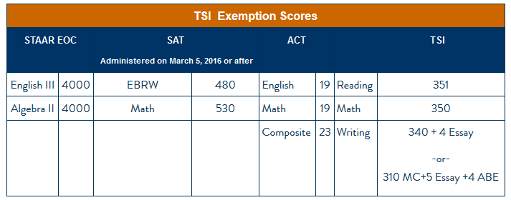
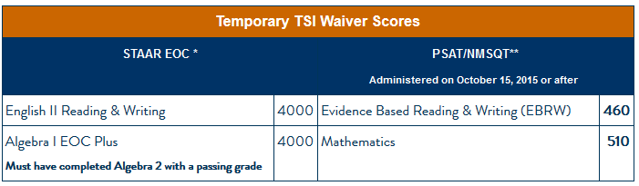
TSI Required Scores

Slide 4
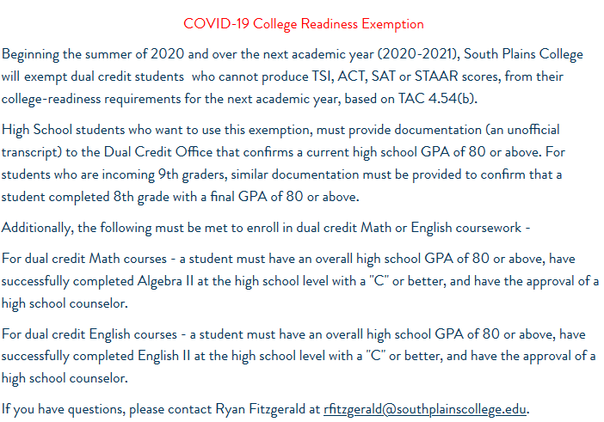
TSI Changes (cont.)
Dual Credit Exemption –

Slide 5
TSIA 2.0
Original launch was scheduled for August 2020, then scheduled for Monday, September 28th, 2020.
UPDATE – TSIA 2.0 rollout now scheduled for January 2021.
Proposed Changes
Revised Standards
Reading and Writing will be integrated (will only be two tests – Math & ELAR – essay component will still be required)
Original Plan - Students will be able to use the current TSIA results for placements through fall 2020, but any placements for spring 2021 and later will require using TSIA 2.0.
Change - After receiving feedback from stakeholders and with test administration capacities still impacted, the determination was made to align TSIA and TSIA 2.0 effective dates to be up to five (5) years from date of testing.
- Statewide webinar on this issue will be out next month

Slide 6
TSI Changes & COVID-19
Questions?
Ryan Fitzgerald, M.A.
(806) 716-2542
rfitzgerald@southplainscollege.edu

Slide 7
South Plains College
2020 Administrator & Adjunct Update
Faculty Update
Ryan Fitzgerald & JimAnn Batenhorst
We will begin shortly!

Slide 8
Dual Credit – Credentialing
What is Dual Credit? A system under which an eligible high school student enrolls in college course(s) and receives credit for the course(s) from both the college and the high school.
Who is eligible to teach?
Academic Transfer – Master’s degree with at least 18 graduate hours in the teaching discipline.
Career and Technical Education – Either a bachelor’s degree in the teaching discipline or an associate’s degree with demonstrated competencies in the discipline.
Notes:
Where do these requirements come from…? SACSCOC

Slide 9
Dual Credit – Instructional Requirements
Curriculum
The college must ensure that a dual credit course and the corresponding course offered at the main campus of the college are equivalent with respect to curriculum, materials, instruction, and method/rigor of student evaluation.
Faculty
Faculty must meet the same standards and approval procedures used by the college to select faculty responsible for teaching the same courses at the main campus of the college.
The college shall supervise and evaluate instructors of dual credit courses using the same procedures used for faculty at the main campus of the college.

Slide 10
What Courses are Available for Dual Credit?
What courses are eligible?
Those in the core curriculum of the public institution of higher education providing the credit;
a career and technical education course; or
a foreign language course.
*No developmental education or remedial courses can be offered for dual credit.

Slide 11
Courses (cont.)
Exception -
Courses offered as part of an early college program…
Any college course for dual credit offered as part of an early college program must be a core curriculum course of the public institution of higher education providing the credit, a career and technical education course, a foreign language course, or course that satisfies specific degree plan requirements leading to the completion of a Board approved certificate, AA, AS, AAS degree program, or FOS.

Slide 12
Adjunct Expectations
Attend at least one department meeting per year;
Submit course syllabi each semester;
Verify class rosters each semester when notified by the Registrar;
Submit final course grades by the deadline set by the Admissions and Records Office each semester;
Submit an SPC grade book to the Admissions and Records Office at the end of each semester;
Provide instruction consistent with departmental objectives and expectations;
Adhere to SPC and departmental policies regarding grading, textbooks, evaluations, and curriculum;
Check SPC email on a regular basis to stay apprised of information from SPC.

Slide 13
Course Syllabi
Course syllabus must include all mandatory syllabus statements, which include the College’s Diversity Statement, Disability Statement, Nondiscrimination Policy, & Title IX Pregnancy Accommodations Statement.
Course syllabi must be submitted electronically to both the academic department’s administrative assistant and to the Dual Credit Office.
Submission deadline is August 24th
Include course & section numbers, title, and correct dates.

Slide 14
SPC Curriculum Vitae (CV)
New instructors need to submit a completed CV form to the Dual Credit Office.
Returning instructors are encouraged to update their CV as changes occur.
Vitae will be posted on the SPC website along with course syllabi.
Vitae needs to be submitted by the first day of class (August 24th).

Slide 15
Class Rosters
Verify your class rosters before the 12th class day.
Students can’t be enrolled after the 12th class day - September 9th.
Instructions will be emailed to you from the Registrar on the 13th class day, detailing the roster verification process.

Slide 16
Final Grades
Instructions for submitting final grades will be sent to your SPC email address, from the Registrar.
Grades must be submitted through Colleague Self-Service by the deadline.
(You will also be asked to submit your gradebook to the Registrar’s Office)
Instead of submitting a traditional letter grade, all dual credit instructors will select a final numeric value - if a student has earned an "87" in class, the instructor will select "87" from the drop down menu - behind the scenes that grade will translate to a letter grade of a "B" on the student's academic record and transcript.
Grade Change Forms can be submitted to the Dual Credit Office - must be completed within 6 months.
FERPA

Slide 17
Course Evaluations
Students must complete an online evaluation instrument towards the end of each semester – students will be notified when course evaluations are open.
Evaluations are an accreditation requirement.
Beginning the 2020-2021 academic, on-site visits will be made to evaluate dual credit instruction.

Slide 18
Stipends
Stipends are paid through direct deposit on October 1, November 1, and December 1 for the fall semester and on March 1, April 1, and May 1 for the spring semester.
Stipends are based on class enrollment as of the official census date (the 12th class day) of each semester.

Slide 19
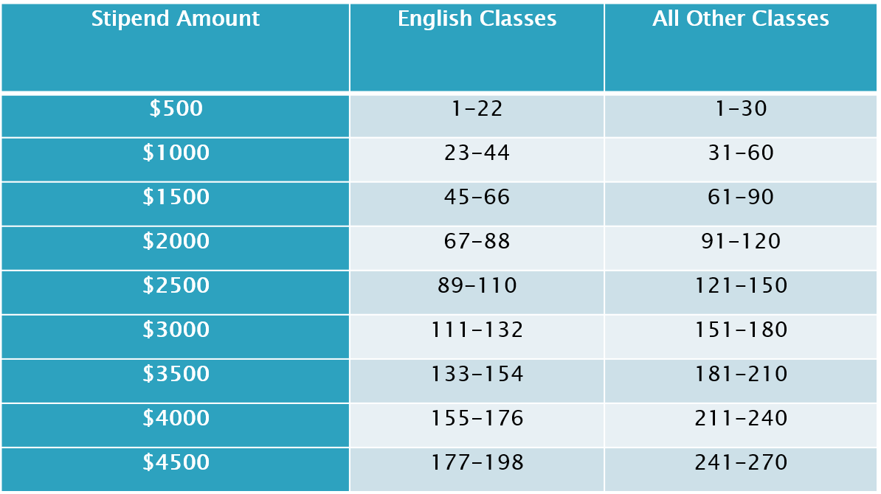
Stipend Amounts for Academic Transfer Courses

Slide 20
Career and Technical Education
Articulated Credit vs. Dual Credit
Summer Workshops and On-Campus Training
CTE Faculty Stipends
Based on College course limits of 24 students – for every 24 students, teachers will receive a $100 stipend.

Slide 21
Questions?
Ryan Fitzgerald
(806) 716-2542
rfitzgerald@southplainscollege.edu
JimAnn Batenhorst
(806) 716-2503
jbatenhorst@southplainscollege.edu

Slide 22
South Plains College
2020 Administrator & Adjunct Update
Academic Update
Ryan Fitzgerald
We will begin shortly!

Slide 23
Degree Requirements
Common Core – 42 semester credit hours that fulfill the general education requirements of degree programs on the associate degree or baccalaureate degree levels.
Core for an Associate of Arts Degree Seeker:
Communications Component Area (6 Hours) - ENGL 1301 & 1302
Mathematics (3 Hours)
Life & Physical Science (6 Hours)
Language, Philosophy & Culture (3 Hours)
Creative Arts (3 Hours)
American History (6 Hours)
Government (6 Hours)
Social/Behavioral Science (3 Hours)
Institutional Option (6 Hours)
Additional Requirements
PE (2 Hours)
Electives (16 Hours)

Slide 24
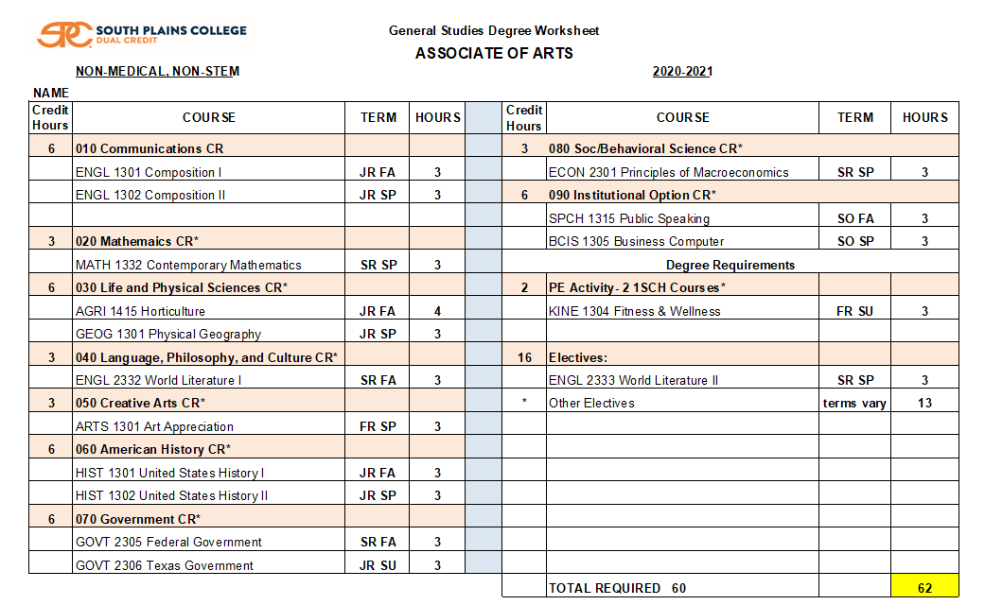
Degree Requirements (cont.)

Slide 25
Degree Requirements (cont.)
Difference between the Associate of Arts & Associate of Science?
Associate of Science requires an additional Mathematics course (for 6 total hours) and eight hours of Lab Sciences (traditionally designed for STEM majors).
The Associate of Science degree only allows 11 hours of elective credit – normally reserved for advanced math or science coursework.
One of the most difficult areas to navigate – choosing the correct math class…

Slide 26
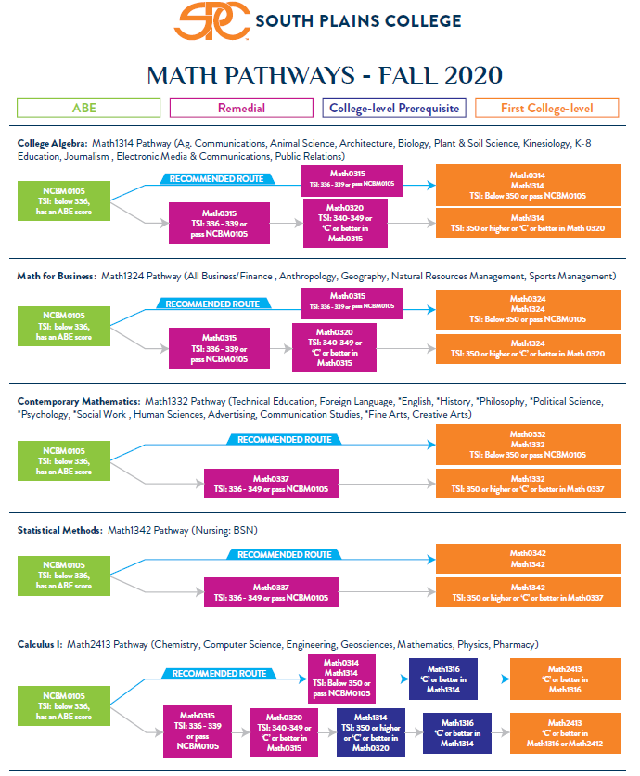

Slide 27
Academic Advising
2019-2020 – hosted advising sessions for over 250 students.
Seniors were contacted towards the end of the spring semester and offered an SPC transition session!
New instructional plans are being posted to SPC’s dual credit webpage!
They can be found on under our “Partner High Schools” tab, here: http://www.southplainscollege.edu/admission-aid/apply/dualcredit/CoursesHighSchool.php!
Career Coach

Slide 28
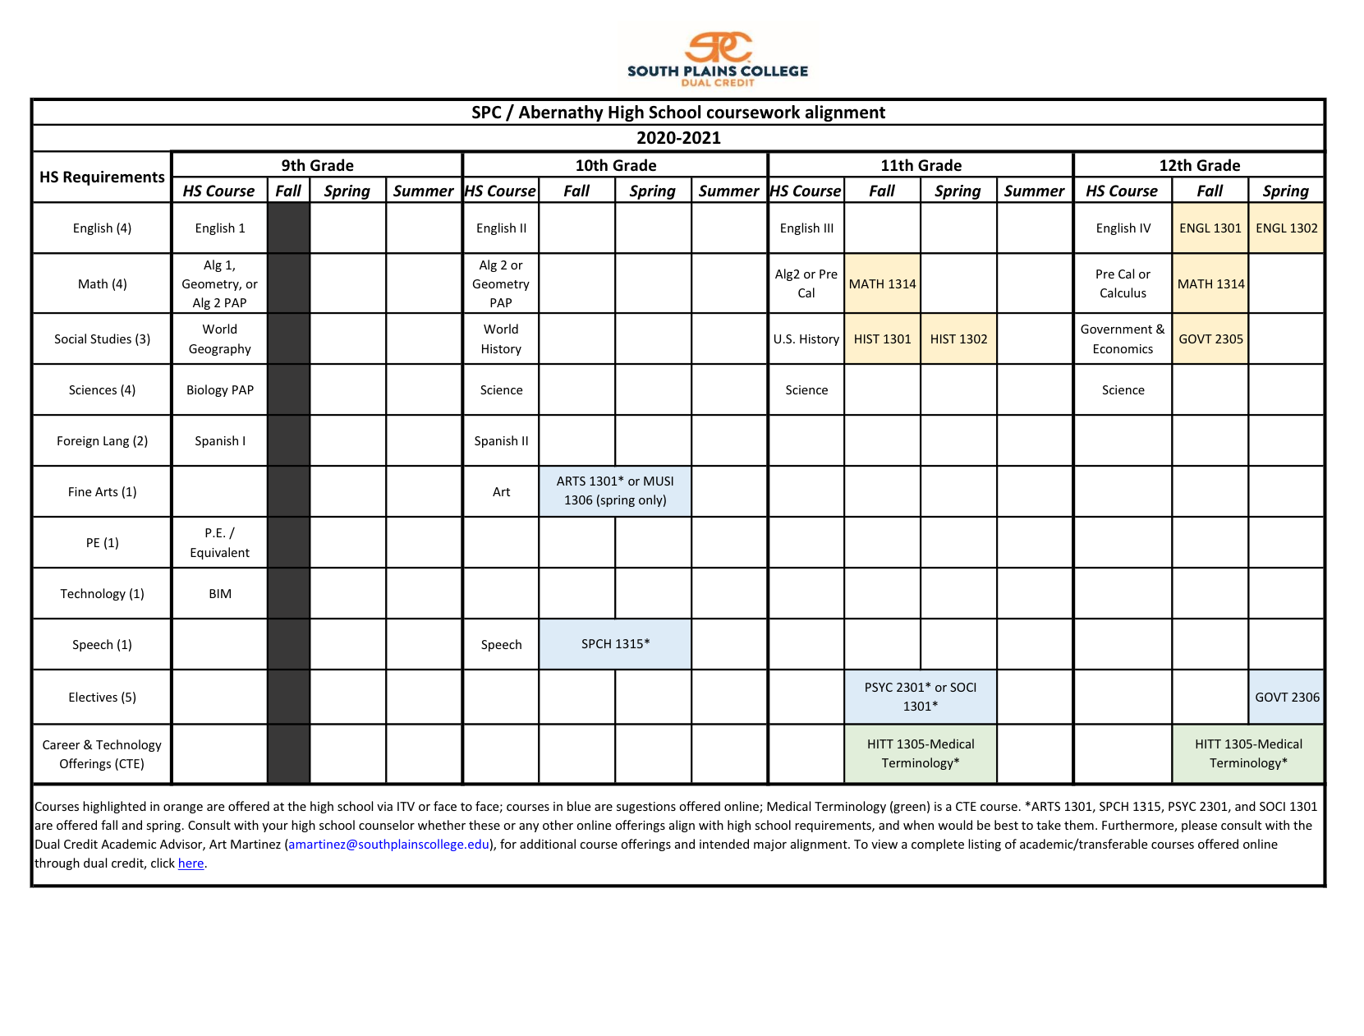
Instructional Plans

Slide 29
Academic Suspension & Probation Policy
Dual Credit Students will be placed on Academic Probation at the end of any term that they do not earn a minimum of 2.00 cumulative GPA.
Students will then have a registration hold placed on their account.
What should Dual Credit Students do that have a probation hold?
Contact their high school counselor;
Complete an Academic Probation Advising Packet (on the SPC Dual Credit webpage);
Schedule a conference call between student, counselor and staff member from the Dual Credit Office for advisement, hold removal and enrollment.

Slide 30
South Plains College
2020 Administrator & Adjunct Update
Student Affairs Update
JimAnn Batenhorst
We will begin shortly!

Slide 31
Business Office Updates
Payment Plans
· $30 Non-refundable fee
· 50% down payment required on or before August 28th - then 25% due on
October 5th and on November 5th
· Payment Plans are not available after September 1st
· Adding/Dropping classes after the initial payment
Paying for Student Fees
· Sponsorship lists need to be submitted to Jessica Lopez (jmlopez@southplainscollege.edu) in the Business Office by Friday, August 21st
· Please include each student’s name, SPC ID number and the amount being covered by the district.

Slide 32
Inclusive Access
Text & course materials included in a student’s bill.
Used for BCIS-1305, BUSI-1301, ENGL-1301 & 1302
These materials will appear in each student’s Blackboard on August 24th, when their courses become available.
No physical textbooks are being sent via U.S. Mail.
Students are allowed to opt-out by the 12th class day – September 9th

Slide 33
Dual Credit Stipends
Faculty and counselor stipends are based of course enrollment, as of September 9th – the College’s Census date.
New dual credit coordinators will need to complete a W-9 form.
Schools with multiple coordinators will have their stipend amount divided equally.

Slide 34
Registration Updates
August 24th - First day of class.
(Blackboard will be made available to students on this date)
August 28th - Dual Credit payment deadline – last day to add an ITV or online class.
September 9th - Last day to a dual credit course that’s being offered at a high school
location. This date is also the 12th class day and serves as the College’s official census date.
For students who register before August 28th - payment is due no later than close of business
on August 28th.
For students who register after August 29th - payment will be due that same day of
registration.

Slide 35
Scheduling Fall Classes
Please let us know if you have course additions or deletions.
Please let us know if you have instructor changes.
Please let us know if any staff contact information needs to be updated or changed.

